Slide 1
Introduction to Transformer
Quang Duong

Slide 2
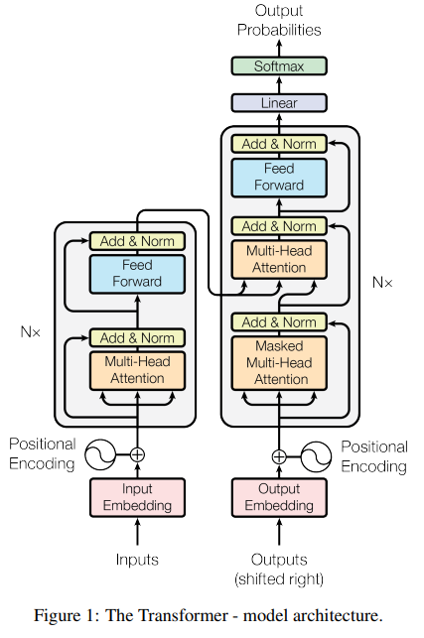
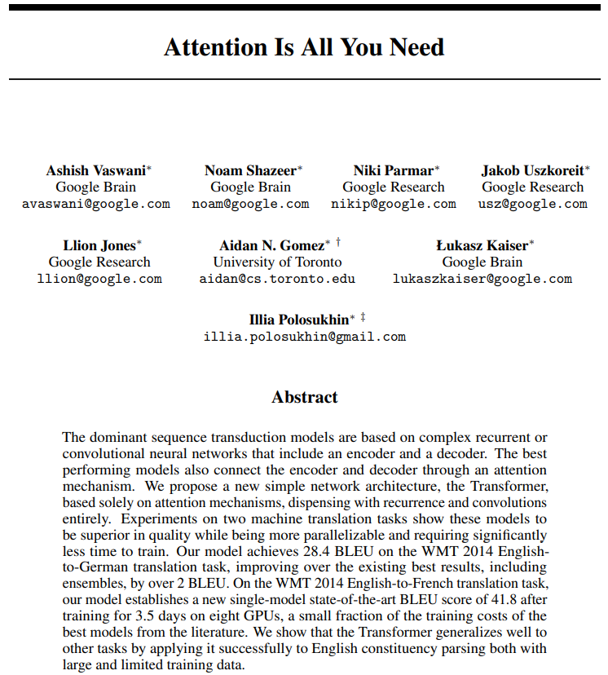
Transformer's origin
Attention Is All You Need, A. Vaswani et al, 2017, https://arxiv.org/abs/1706.03762

Slide 3


Transformer for lingual translation
Prediction:
"Je vais bien"
Transformer
Decoder
Encoder
Source:
"I am fine"
Simplified transformer architecture

Slide 4
Model requirements for data input
Source:
Target/Label:
"I am fine"
"Je vais bien"
"Thank you very much"
"Merci beaucoup"
"I cook French cuisine"
"Je fais la cuisine française"
Model only understand numerical value -> transform from text to numerical representation
Source and target texts may have different word length -> A fixed sequence length is needed for the model processing
Model need to know when to start and notify when to end its prediction

Slide 5
From Text to Numerical representation
Source:
"I am fine"
"Thank you very much"
"I cook French cuisine"

Slide 6
Inference
Prediction:
"Je vais bien"
Je
vais
bien
<EOS>
Decoder
Decoder
Decoder
Decoder
<SOS>
<SOS> Je
<SOS> Je vais
<SOS> Je vais
<SOS> Je vais bien
Encoder
Encoder
Encoder
Encoder
<SOS> I am fine <EOS>
<SOS> I am fine <EOS>
<SOS> I am fine <EOS>
<SOS> I am fine <EOS>
Source:
"I am fine"
t1
t2
t3
t4

Slide 7
Inference
t1
Je
Decoder
Encoder
<SOS> I am fine <EOS>
<SOS>
Source:
"I am fine"

Slide 8
Inference
t2
Je
Decoder
Encoder
<SOS> I am fine <EOS>
<SOS>
Source:
"I am fine"

Slide 9
Inference
t2
vais
Decoder
Encoder
<SOS> I am fine <EOS>
<SOS> Je
Source:
"I am fine"

Slide 10
Inference
t3
vais
Decoder
Encoder
<SOS> I am fine <EOS>
<SOS> Je
Source:
"I am fine"

Slide 11
Inference
t3
bien
Decoder
Encoder
<SOS> I am fine <EOS>
<SOS> Je vais
Source:
"I am fine"

Slide 12
Inference
t4
bien
Decoder
Encoder
<SOS> I am fine <EOS>
<SOS> Je vais
Source:
"I am fine"

Slide 13
Inference
t4
Prediction:
"Je vais bien"
EOS
Decoder
Encoder
<SOS> I am fine <EOS>
<SOS> Je vais bien
Source:
"I am fine"

Slide 14
Training
Label:
"Je vais bien"
t1
Je vais bien <EOS>
Cross Entropy Loss
X Y Z
Decoder
Encoder
Update model parameters
<SOS> I am fine <EOS>
<SOS> Je vais bien
Source:
Label:
"I am fine"
"Je vais bien"

Slide 15
Training
Label:
"Je t'aime"
t2
Je t'aime <EOS>
Cross Entropy Loss
A B C
Decoder
Encoder
Update model parameters
<SOS> I am fine <EOS>
<SOS> Je t'aime
Source:
Label:
"I love you"
"Je t'aime"

Slide 16
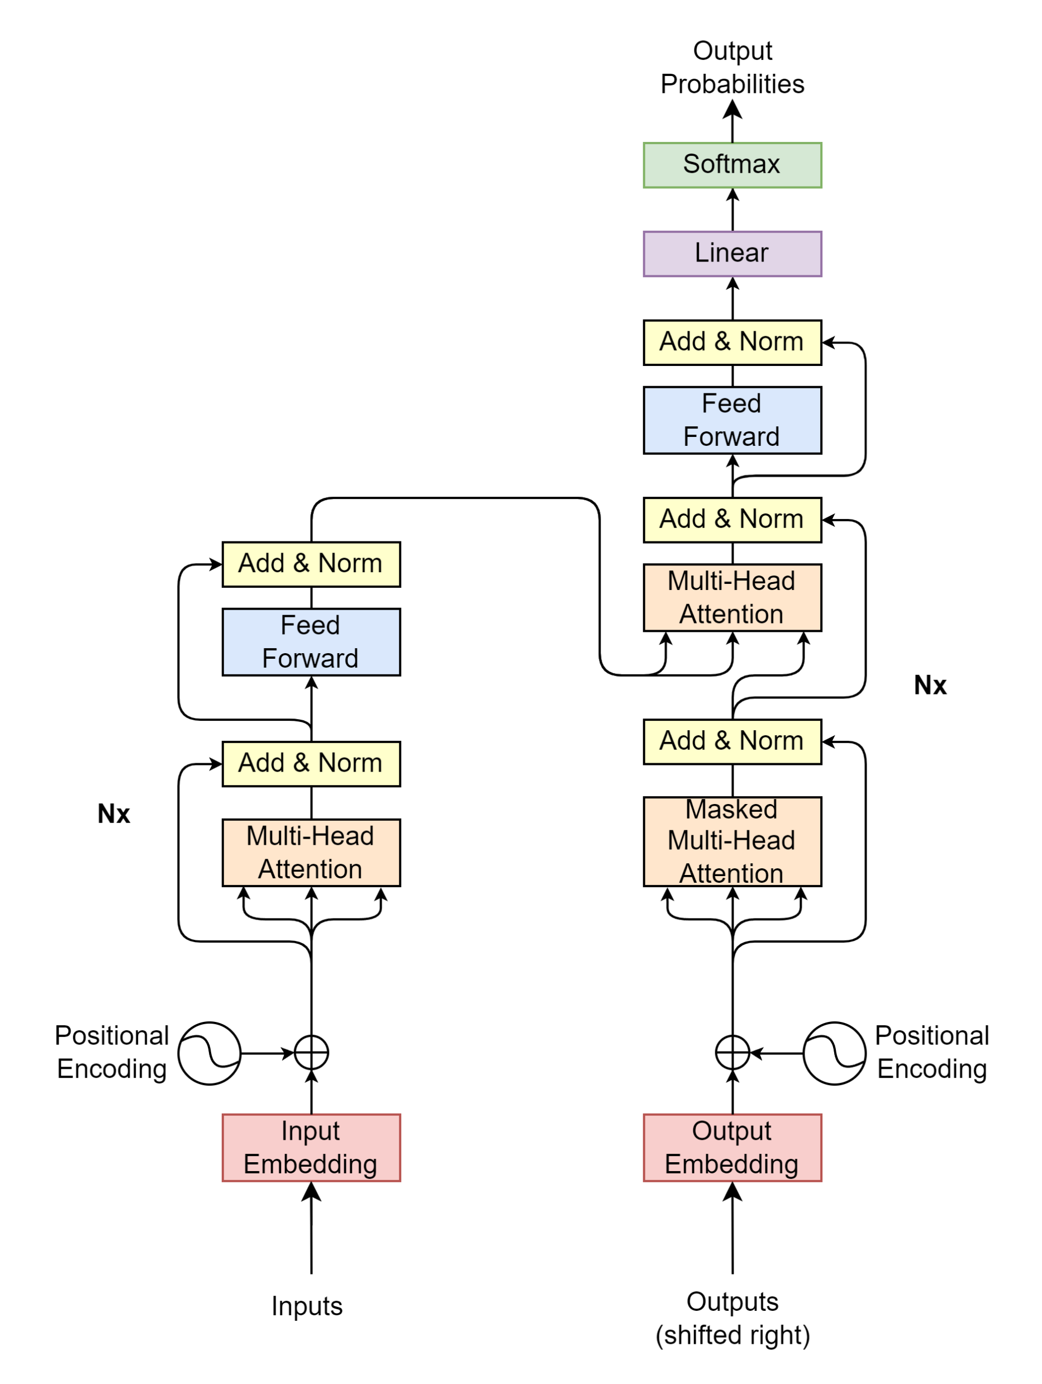
Transformer blocks
Projection
Decoder
Encoder
Encoder Input
Decoder Input

Slide 17
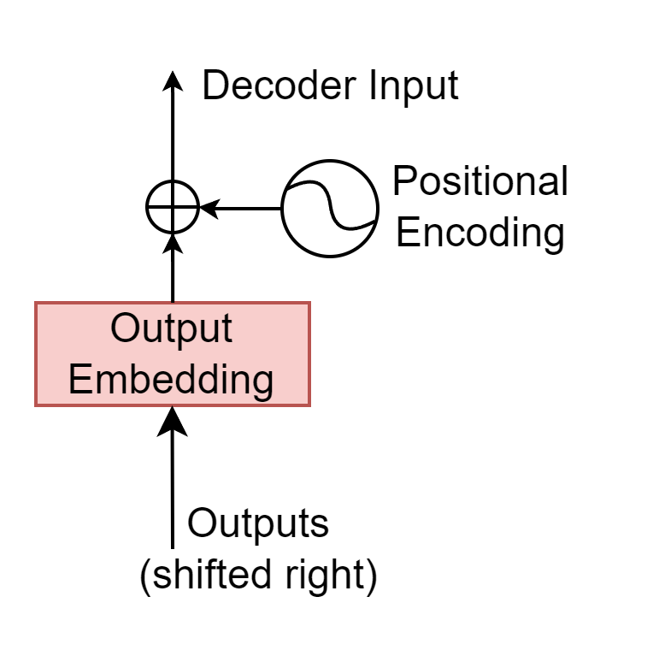
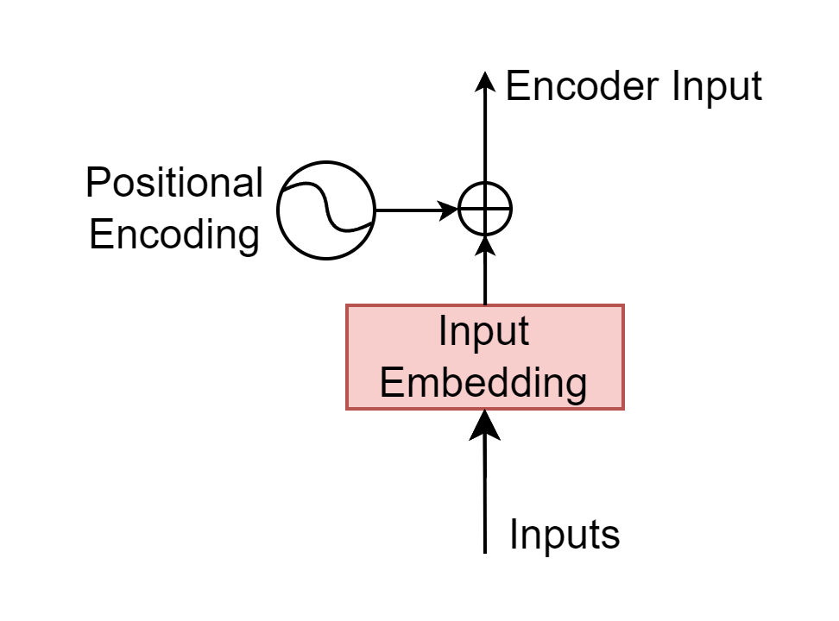
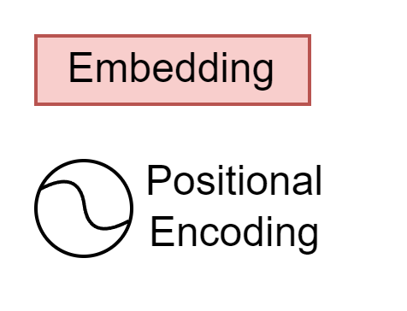


Encoder/Decoder Input
Tensor $\left(seq, d_{model}\right)$
Tensor $\left(seq, d_{model}\right)$
<SOS> I am fine <EOS>
<SOS> Je vais bien
Encoder Input
Decoder Input

Slide 18
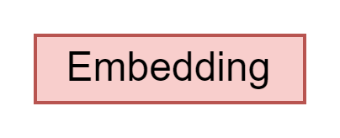
Encoder/Decoder Input

